Slide 1
New Trends in Operating System
Topic Covered
Real Time OS
Distributed OS
Cloud OS
Mobile OS
Security in OS
Memory Wall & Performance Bottlenecks

Slide 2
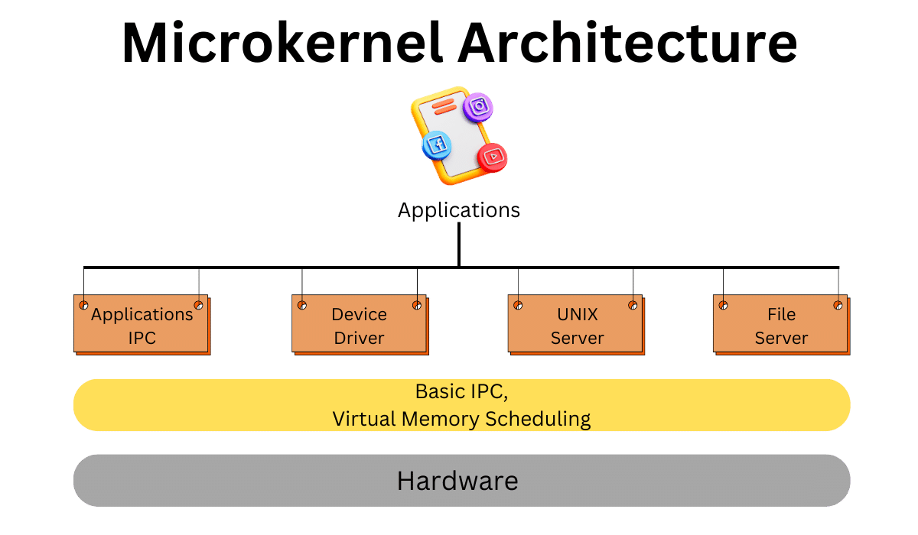
Introduction to Operating Systems
OS: Core software managing hardware and software resources.
Acts as an interface between users and hardware.
Provides essential services: resource allocation, process management, I/O handling.
Critical for system efficiency and stability.

Slide 3
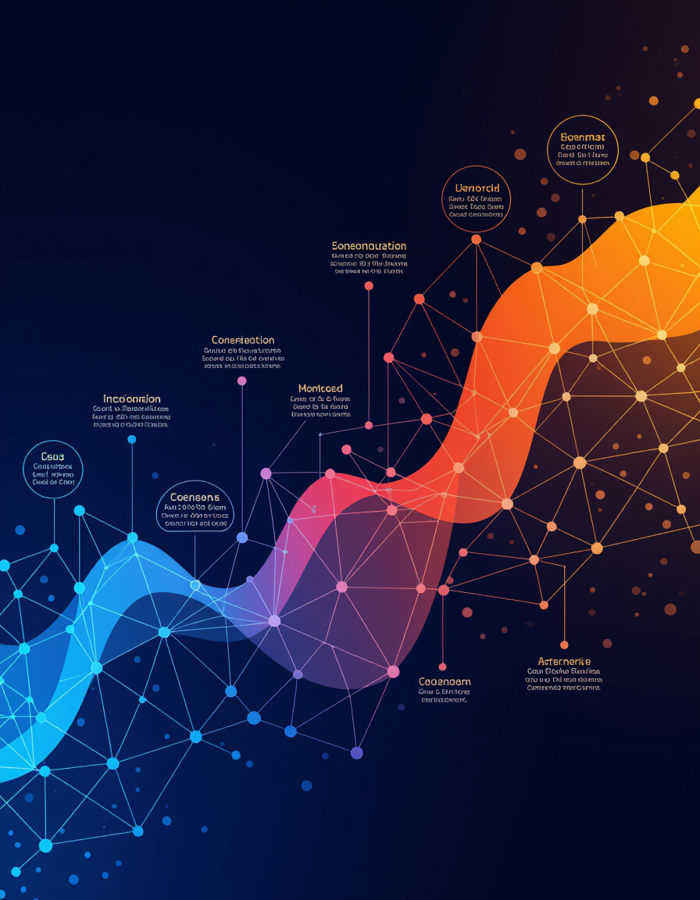
Evolution of Operating Systems
Batch Systems: Early OS, processed jobs sequentially.
Multiprogramming: Allowed multiple programs to share CPU.
Time-Sharing: Interactive systems with quick response times.
Modern OS: Complex, feature-rich, supporting diverse applications.
Key milestones: UNIX ,Linux.

Slide 4
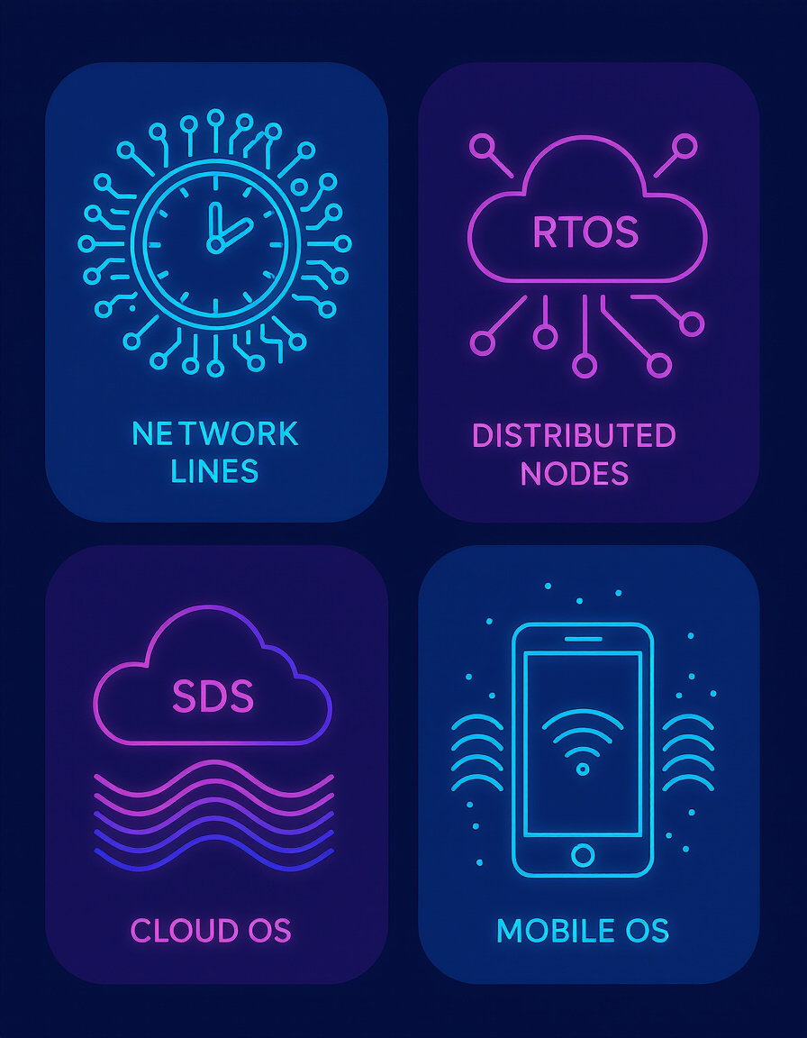
New Trends in Operating Systems
Real-Time OS (RTOS): For time-critical applications.
Distributed OS: Manages multiple networked systems as one.
Cloud OS: Virtualized resource management in the cloud.
Mobile OS: Tailored for smartphones, tablets, and IoT devices.

Slide 5
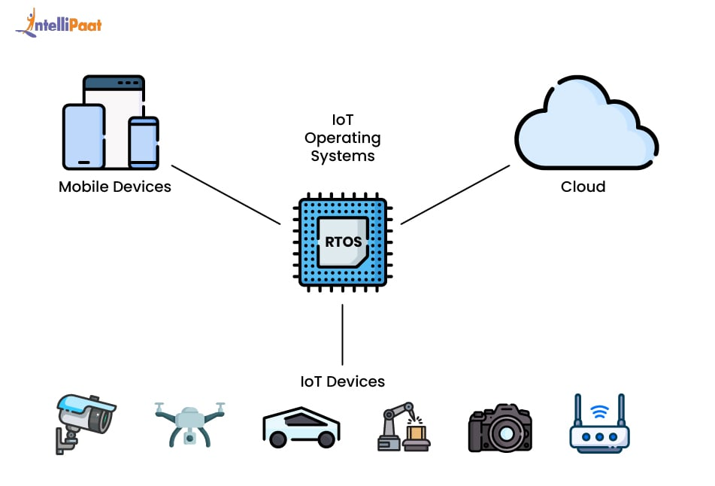
Real-Time OS Concept
RTOS: Designed for applications requiring time-bound execution.
Guarantees response within specific time constraints.
Critical in systems where delays can be catastrophic.
Examples: Industrial control, aerospace, robotics.

Slide 6
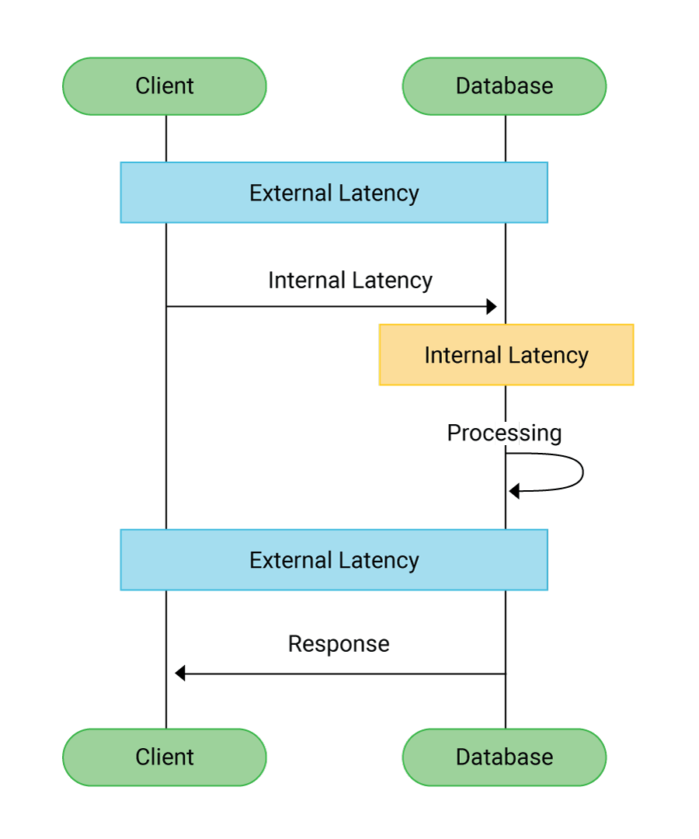
RTOS Characteristics
Low Latency: Minimal delay in responding to events.
Determinism: Predictable execution times.
Reliability: High uptime and fault tolerance.
Priority-Based Scheduling: Prioritizescritical tasks.

Slide 7
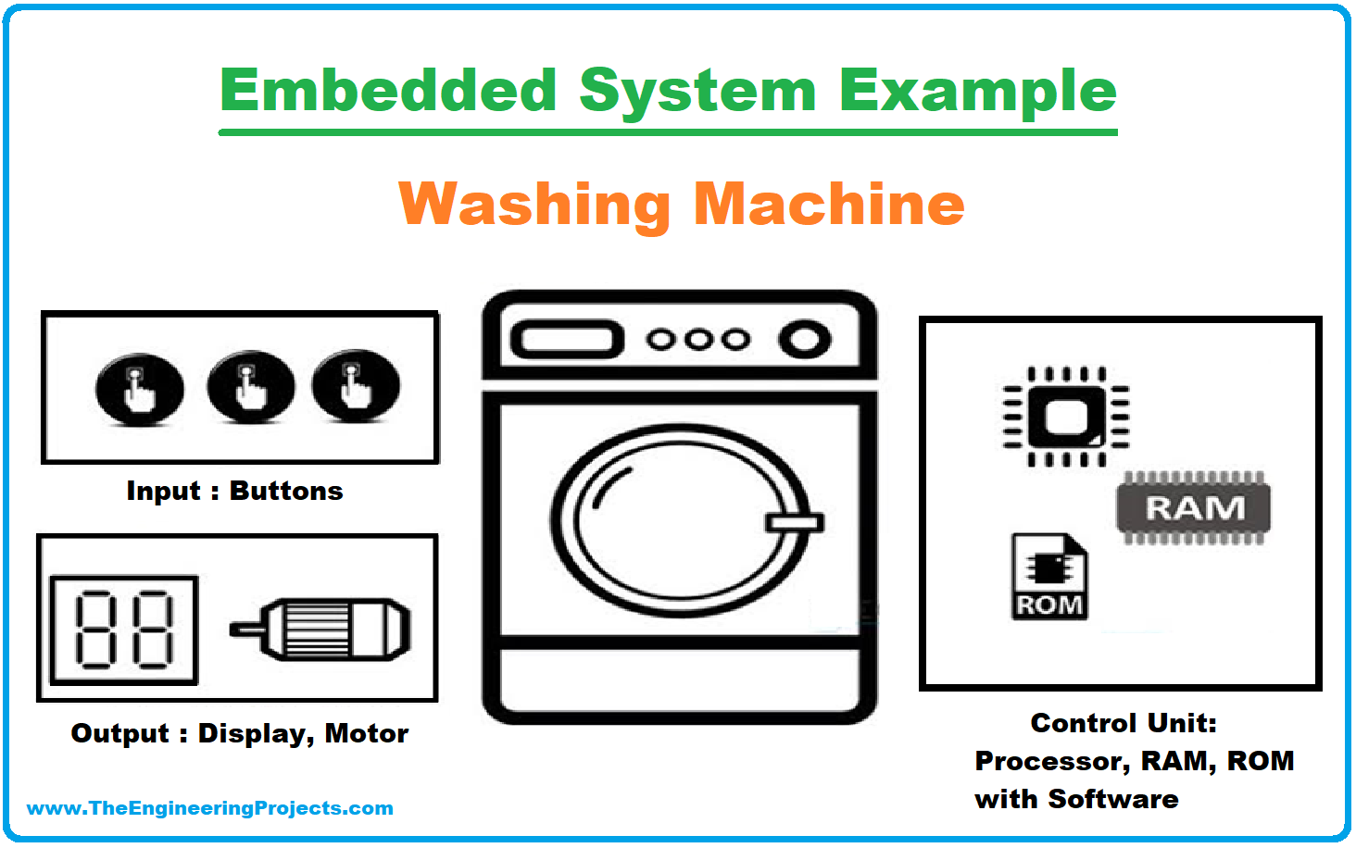
RTOS Applications
Embedded Systems: Washing Machines, Microwaves, etc.
Medical Devices: Patient monitoring systems, MRI machines.
Automotive: Engine control, anti-lock braking systems (ABS).
Industrial Automation: Robotics, process control systems.

Slide 8
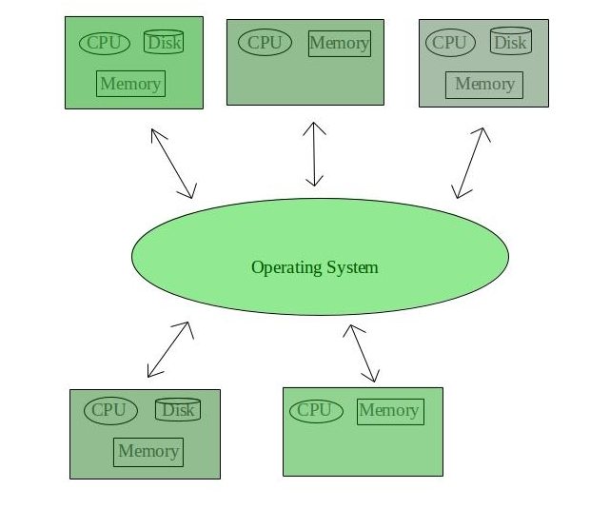
Distributed OS Concept
Distributed OS: Manages a network of independent computers as a single system.
Provides resource sharing and fault tolerance.
Enhances system scalability and performance.

Slide 9
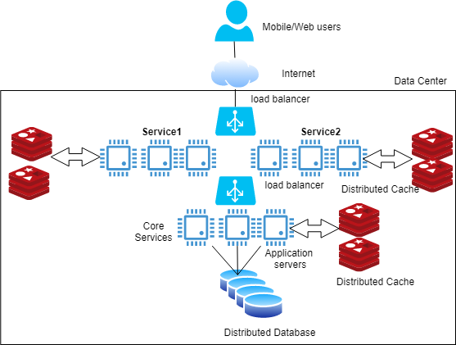
Distributed OS Characteristics
Scalability: Ability to add more nodes to the system.
Transparency: Hides the distributed nature from users.
Fault Tolerance: Continues operating despite node failures.
Resource Sharing: Allows sharing of hardware and software resources.

Slide 10
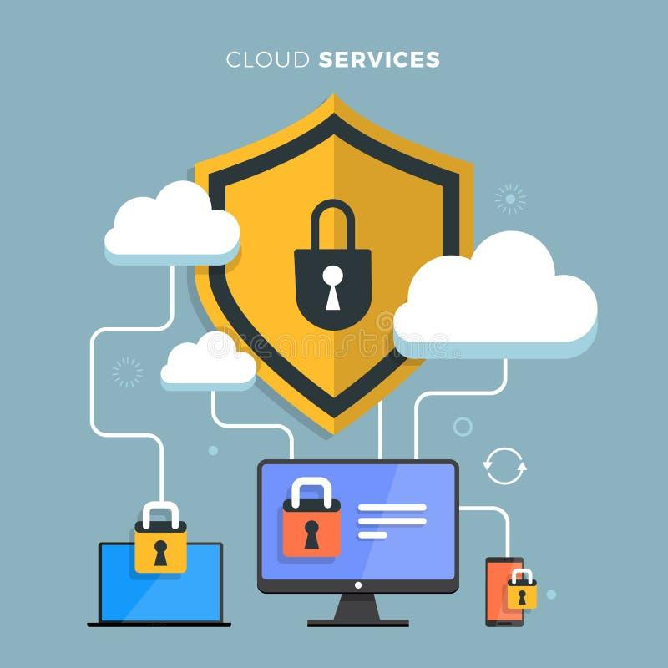
Distributed OS Applications
Cloud Computing: AWS, Azure, Google Cloud.
Enterprise Systems: Banking systems, supply chain management.
Content Delivery Networks (CDNs): Akamai ,Cloudflare.

Slide 11
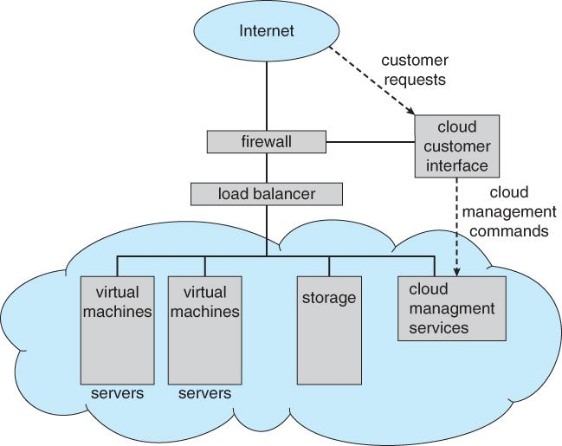
Cloud OS Concept
Cloud OS: Manages virtualized resources in a cloud environment.
Provides on-demand access to computing resources.
Supports elasticity and multi-tenancy.

Slide 12
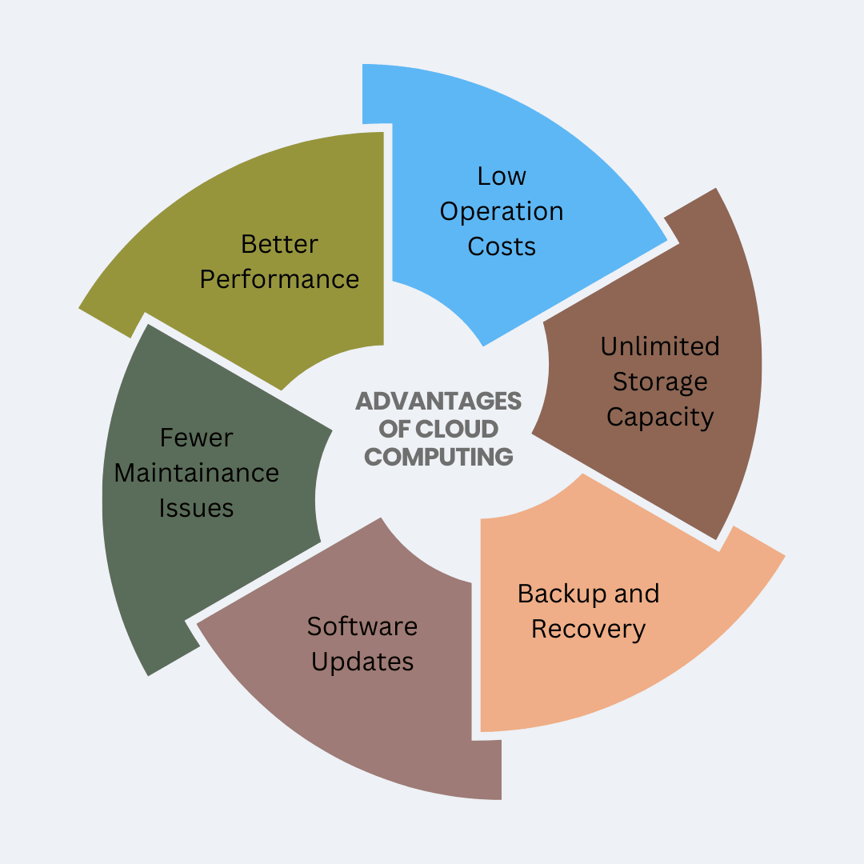
Cloud OS Characteristics
Elasticity: Dynamically scales resources based on demand.
Multi-Tenancy: Supports multiple users/organizations on shared infrastructure.
Virtualization: Enables efficient resource utilization.
Automation: Automates deployment and management tasks.

Slide 13
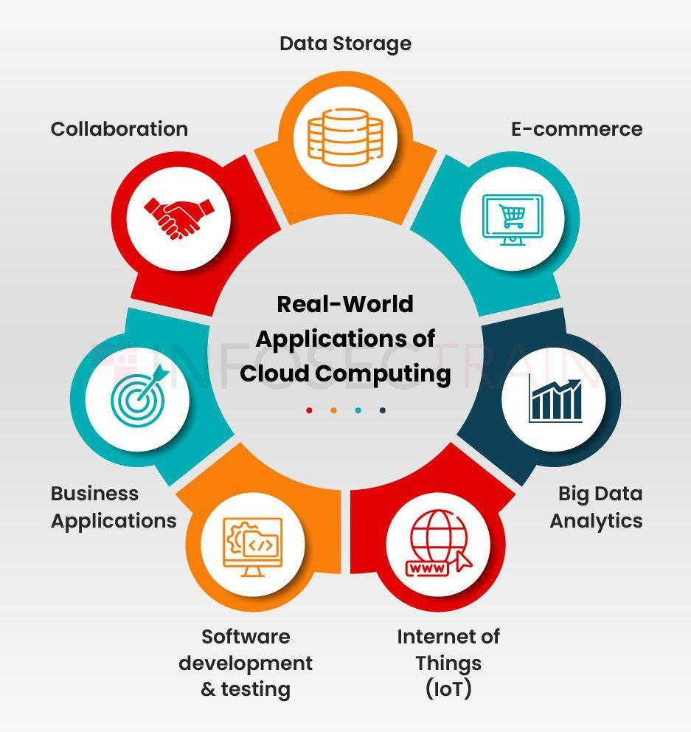
Cloud OS Applications
Data Centers: Management of servers and storage.
Software as a Service (SaaS): Salesforce, Office 365.
Platform as a Service (PaaS): Heroku, Google App Engine.
Infrastructure as a Service (IaaS): AWSEC2, Azure VMs.

Slide 14
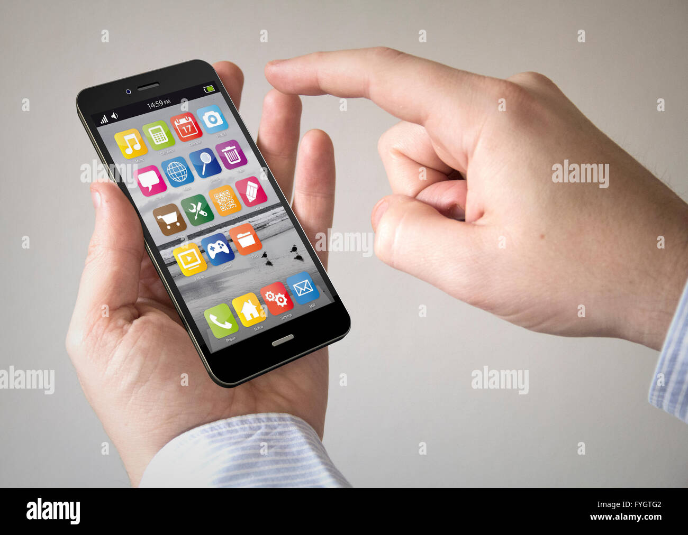
Mobile OS Concept
Mobile OS: Operating system designed for mobile devices.
Optimized for touch-based interfaces and power efficiency.
Supports mobile applications and wireless communication.

Slide 15

Mobile OS Characteristics
Touch UI: User interface optimized for touch input.
Power Management: Efficient use of battery power.
Mobile Applications: Support for apps via app stores.
Connectivity: Wireless communication (Wi-Fi, cellular).

Slide 16
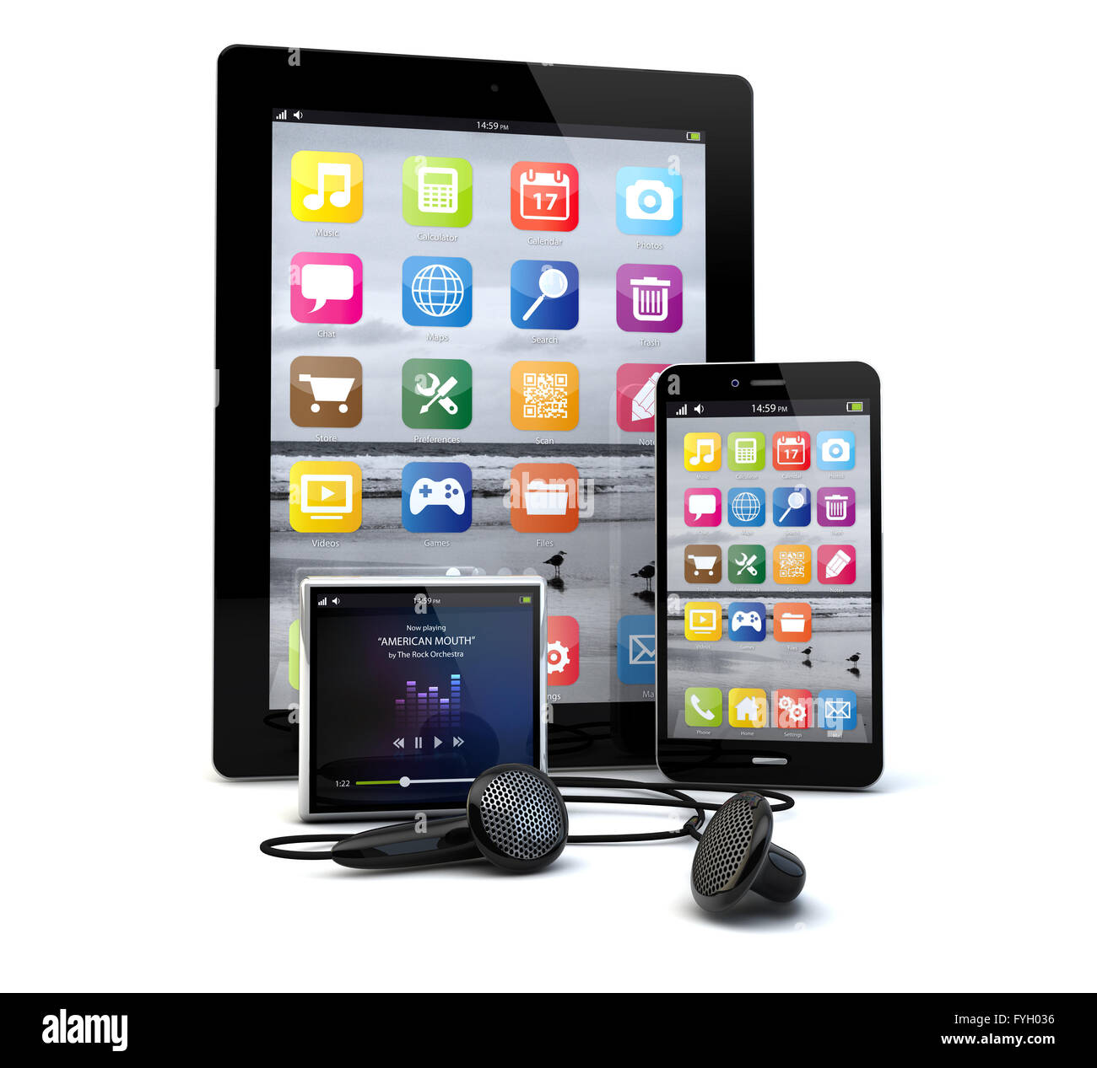
Mobile OS Applications
Smartphones: iOS, Android.
Tablets: iPads, Android tablets.
Internet of Things (IoT): Wearable devices, smart home devices.

Slide 17
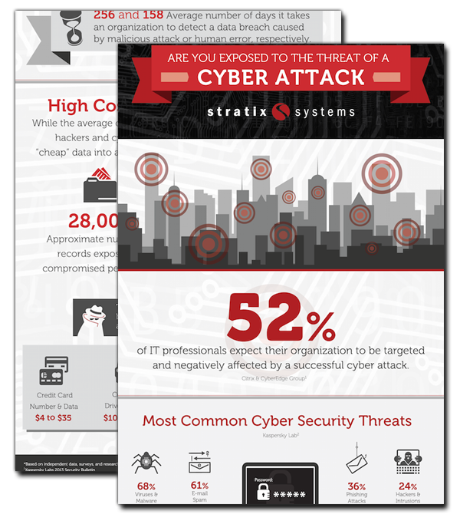
Security Issues
Malware: Viruses, worms, trojans targeting OS vulnerabilities.
Data Breaches: Unauthorized access to sensitive data.
Phishing: Deceptive attempts to steal user credentials.
Denial of Service (DoS): Overwhelming systems to make them unavailable.

Slide 18
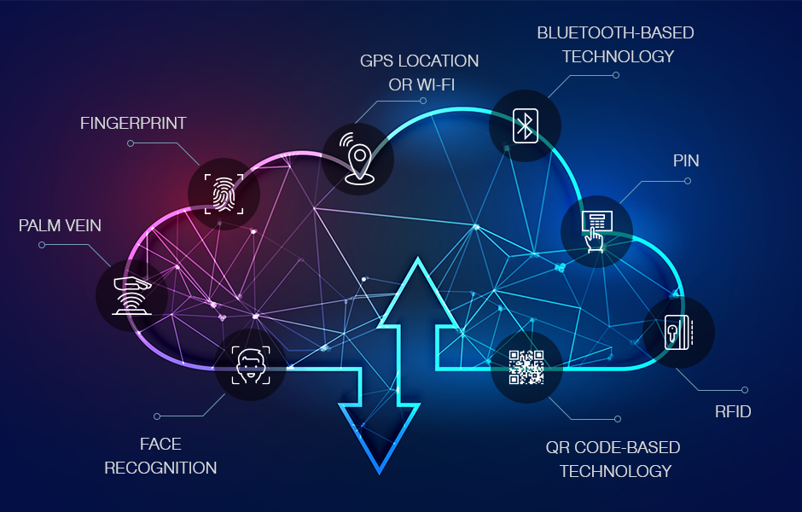
Security Deployment Methods
Authentication: Verifying user identity (passwords, biometrics).
Encryption: Protecting data confidentiality using cryptographic algorithms.
Firewalls: Controlling network traffic to prevent unauthorized access.
Antivirus Software: Detecting and removing malware.

Slide 19
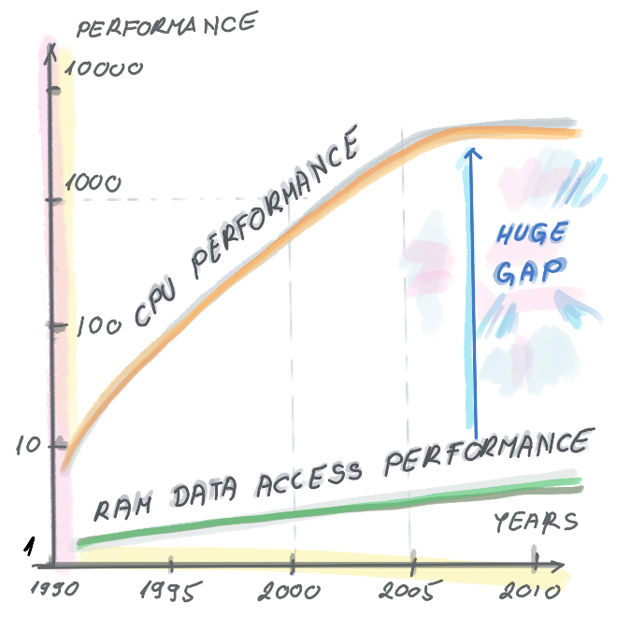
Memory Wall
Memory Wall: The widening gap between CPU speed and memory access speed.
CPUs are getting faster, but memory isn't keeping up.
This disparity leads to performance bottlenecks.
Impact: Limits overall system performance.

Slide 20
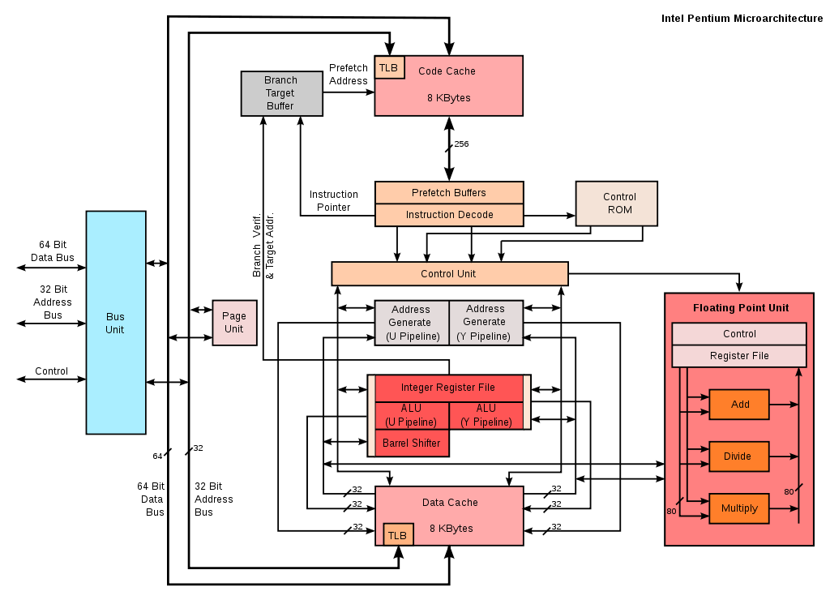
Bottlenecks & Conclusion
CPU Limits: Overloaded CPUs can limit performance.
I/O Limits: Slow I/O operations can cause delays.
Memory Wall: Disparity between CPU and memory speeds.
Future Trends: Focus on efficient resource management, security, and addressing hardware limitations.

Slide 21
THANK YOU

